Slide 1

VISVESVARAYA TECHNOLOGICAL UNIVERSITY
A PROJECT ON
FORECASTING STOCK PRICE USING
ARTIFICIAL NEURAL NETWORKS
Submitted by
BHARATH R [4VV17CS123]
SHANKARNARAYAN P [4VV17CS085]
SHRINIVAS B BHAVIHAL [4VV17CS122]
Under the Guidance of
Dr.GURURAJ.H.L, Associate Professor,
Prof.SUNIL KUMAR.B.R ,Assistant professor
Department of Computer Science & Engineering VVCE, Mysore.
10-08-2021

Slide 2
INTRODUCTION
A correct prediction of stocks can lead to huge profits for the seller and the broker. Frequently, it is brought out that prediction is chaotic rather than random, which means it can be predicted by carefully analyzing the history of respective stock market. Machine learning is an efficient way to represent such processes. It predicts a market value close to the tangible value, thereby increasing the accuracy. Introduction of machine learning to the area of stock prediction has appealed to many researches because of its efficient and accurate measurements. The vital part of machine learning is the dataset used. The dataset should be as concrete as possible because a little change in the data can perpetuate massive changes in the outcome.

Slide 3
EXISTING SYSTEM
Simplistic Model: This is a simplistic model that directly takes the trend of the last n days of historical price series as the future trend. Hence cannot be considered for short time prediction.
SVM: Support Vector Machine is a machine learning technique used in recent studies to forecast stock prices.These are used as parameters to the SVM model. The model attempts to predict whether a stock price sometime in the future will be higher or lower than it is on a given day.
ARIMA (AutoRegressive Integrated Moving Average): is a forecasting algorithm based on the idea that the information in the past values of the time series can alone be used to predict the future values. It is suitable for short term predictions only.
.

Slide 4
PROPOSED SYSTEM AND OBJECTIVES
In this project the lowest, the highest and the average value of the stock market in the last d days are used to predict the next day’s market value.
Artificial Neural Network (ANN) is a popular method used to incorporate technical analysis for making predictions in financial markets.
The stock market data have been extracted from NSE Stock Market dataset.
In this method, the disorders in the market caused by social or political reasons are not omitted from the data set because we want to predict the value based on the value history and hence we Sentiment Analysis.
The graphical visual obtained from web application gives the clarity on behavior of market thus helping us understand price action.

Slide 5
OBJECTIVES
This model can be used to support trading by using prediction in the trading strategy.
For Simple long short strategy - Buy if the prediction is higher and Sell if the prediction is lower.
For Intraday Trading - if you can get hands on minute data or tick data, we can use this predictor to trade.
The performance plots help to identify the number of iterations (epochs) at which the mean squared error become least or stops changing and identify the movement of particular share to carry out transaction with greater accuracy.

Slide 6
LITERATURE SURVEY
1. Stock Market Prediction Using Machine Learning
Authors: Ishita Parmar, Navanshu Agarwal
Year: 2018
Findings:
In Stock Market Prediction, the aim is to predict the future value of the financial stocks of a company. The recent trend in stock market prediction technologies is the use of machine learning which makes predictions based on the values of current stock market indices by training on their previous values. Machine learning itself employs different models to make prediction easier and authentic. The paper focuses on the use of Regression and LSTM based Machine learning to predict stock values. Factors considered are open, close, low, high and volume

Slide 7
2. Stock Market Prediction Analysis by Incorporating Social and News Opinion and
Sentiment
` Authors: Zhaoxia Wang, Seng-Beng Ho, Zhiping Lin
Year: 2018
Findings
This paper aims to successfully predict stock price through analyzing the relationship between the stock price and the news sentiments. A novel enhanced learning-based method for stock price prediction is proposed that considers the effect of news sentiments. Compared with existing learning-based methods, the effectiveness of this new enhanced learning-based method is demonstrated by using the real stock price data set with an improvement of performance in terms of reducing the Mean Square Error (MSE)

Slide 8
3. Stock market prediction
Authors: RaduIacomin
Year: 2018
Findings
In a financially volatile market, as the stock market, it is important to have a very precise prediction of a future trend. Because of the financial crisis and scoring profits, it is mandatory to have a secure prediction of the values of the stocks. Predicting a non-linear signal requires advanced algorithms of machine learning. The literature contains studies with different machine learning algorithms such as ANN (artificial neural networks) with different feature selection. The results of this study will show that the algorithm of classification SVM (Support Vector Machines) with the help of feature selection PCA (Principal component analysis) will have the success of making a profit

Slide 9
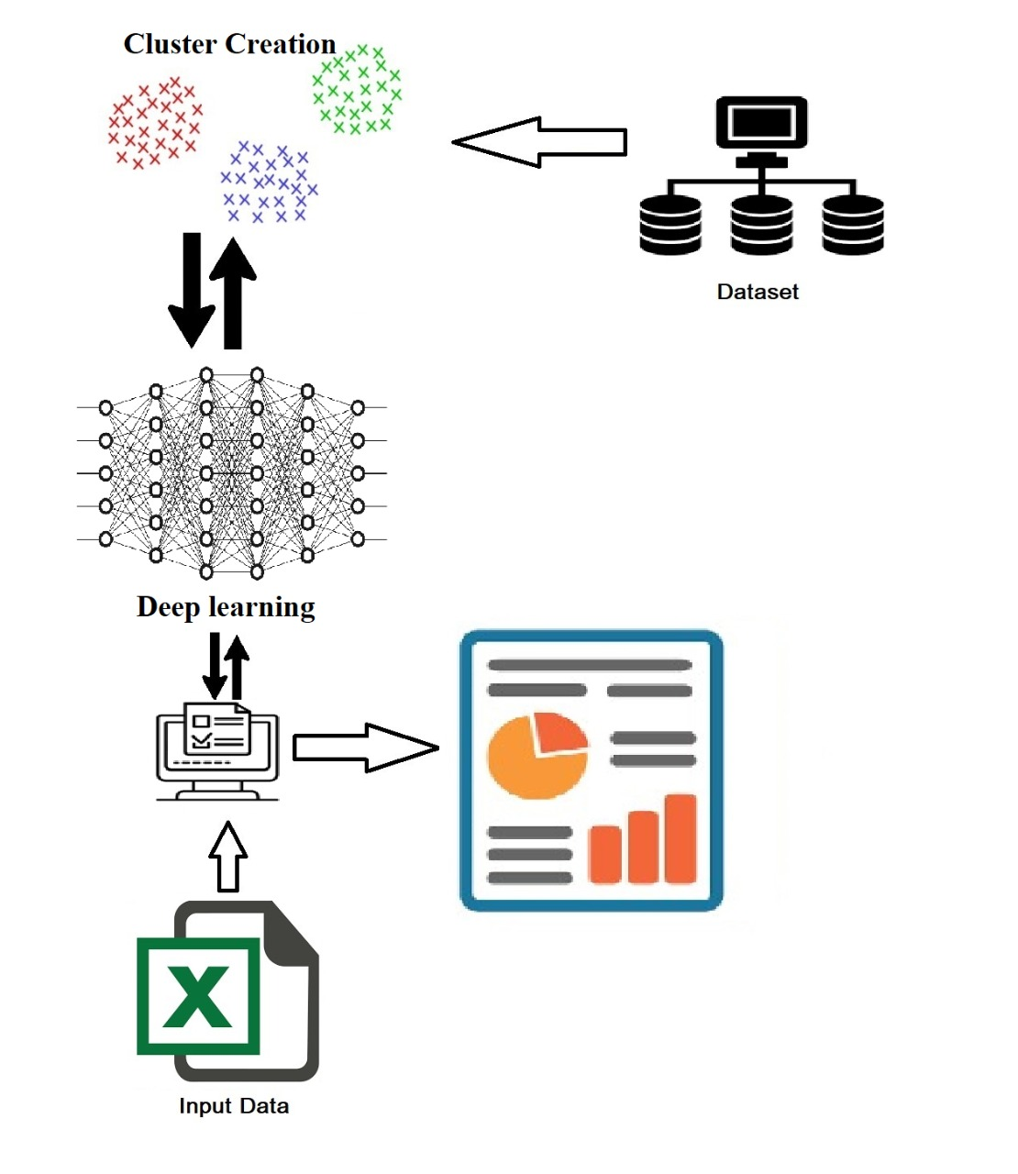
SYSTEM ARCHITECTURE

Slide 10
METHODOLOGY
Different kinds of neural networks may be advanced via the mixture of different factors like community topology, schooling technique and so on. For this test, we have had been given have been given were given taken into consideration Artificial Neural Network and Long Short-Term Memory.
Stage 1: Raw Data: In this stage, the historical stock data is agitated from https://www.quandl.com/data/NSE, and this historical data is utilized for the prediction of future stock prices.

Slide 11
Stage 2: Data Pre-processing: The pre-processing step includes
Data discretization: Part of data reduction but with particular importance, especially for numerical data.
Data transformation: Normalization.
Data cleaning: Fill in missing null values.
Data integration: Integration of data files.
After the dataset is converted into a pure dataset, the dataset is separated into training and testing sets so as to assess. Here, the training values are taken as the more up to date values. Testing data is kept as 5% to 10% of the total dataset.
Stage 3: Feature Extraction: In this layer, only the features which are to be fed to the neural network are chosen. We will choose the feature from Date, open, high, low, close, and volume.

Slide 12
Stage 4: Training Neural Network: In this stage, the data is fed to the neural network and trained for prediction assigning random biases and weights. Our LSTM model is composed of a sequential input layer followed by 2 LSTM layers and a dense layer with ReLU activation and then finally a dense output layer with a linear activation function.
Stage5: Output Generation: In this layer, the output value is shown by the output layer of the ANN, and it is compared with the target value. After the comparison, the error or the difference between the target and derived output which adjusts the weights and the biases of the network.

Slide 13
SYSTEM REQUIREMENTS
Minimum Hardware Requirements
• Processor : Intel i5 2.53GHz
• Hard Disk : 30GB
• Ram : 4 GB or above
Software Requirements
• Operating system : Windows 7 and above
• Coding Language : Python
• Frontend : Flask(HTML5, CSS3, Jquery, Bootstrap)
• Version : 3.7 & above
• IDE : Pycharm/Visual Studio Code

Slide 14
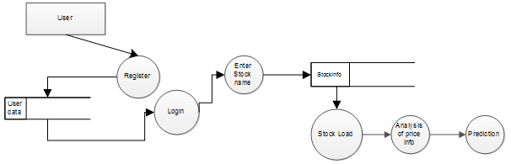
DESIGN DIAGRAM

Slide 15
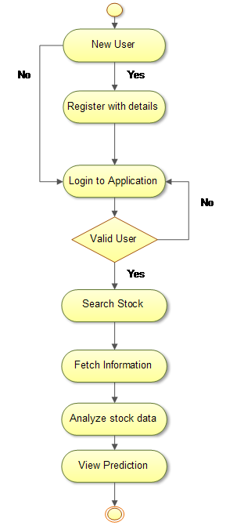
USE CASE DIAGRAM
19-05-2021

Slide 16
TEST CASES
UNIT TEST CASES
Test Case Number | Testing Scenario | Expected result | Result
TC – 01 | Uploading wrong data file | Alert ”File extension not supported ” | Pass
TC – 02 | Uploading without choosing any file | Alert ”Choose a file” | Pass
TC – 03 | View preprocessed data | Show correct data after preprocessing | Pass
TC – 04 | View prediction | Show correct prediction based on the data | Pass
TC – 05 | View prediction in visualizer | Show prediction in visualizations | Pass

Slide 17
CODE SNIPPETS
#LINEAR REGRESSION
def linear_regression(dates, prices, test_date, df):
lin_reg = LinearRegression()
trainX, trainY, testX, testY = create_preprocessed_Dataset(df)
# trainX = [item for sublist in trainX for item in sublist]
# testX = [item for sublist in testX for item in sublist]
X_train, X_test, y_train, y_test = train_test_split(trainX, trainY, test_size=0.33, random_state=42)
lin_reg.fit(trainX, trainY)
decision_boundary = lin_reg.predict(trainX)
y_pred = lin_reg.predict(X_test)
test_score = mean_squared_error(y_test, y_pred)
prediction = lin_reg.predict(testX)[0]
return (decision_boundary, prediction, test_score)

Slide 18
#RANDOM FOREST
def random_forests(dates, prices, test_date, df):
rand_forst = RandomForestRegressor(n_estimators=10, random_state=0)
trainX, trainY, testX, testY = create_preprocessed_Dataset(df)
# trainX = [item for sublist in trainX for item in sublist]
# testX = [item for sublist in testX for item in sublist]
X_train, X_test, y_train, y_test = train_test_split(trainX, trainY, test_size=0.33, random_state=42)
rand_forst.fit(trainX, trainY)
decision_boundary = rand_forst.predict(trainX)
y_pred = rand_forst.predict(X_test)
test_score = mean_squared_error(y_test, y_pred)
prediction = rand_forst.predict(testX)[0]
return (decision_boundary, prediction, test_score)

Slide 19
#LSTM
def LSTM_model(dates, prices, test_date, df):
df.drop(df.columns.difference(['date', 'open']), 1, inplace=True)
df = df['open']
dataset = df.values
dataset = dataset.reshape(-1, 1)
dataset = dataset.astype('float32')
# split into train and test sets
train_size = len(dataset) - 2
train, test = dataset[0:train_size, :], dataset[train_size:len(dataset), :]
# create and fit the LSTM network
model = Sequential()
model.add(LSTM(4, input_shape=(1, look_back)))
model.add(Dense(1))
model.compile(loss='mean_squared_error', optimizer='adam')
model.fit(X_train, y_train, epochs=100, batch_size=1, verbose=2)
# make predictions
trainPredict = model.predict(X_train)
mainTestPredict = model.predict(X_test)
testPredict = model.predict(testX)

Slide 20
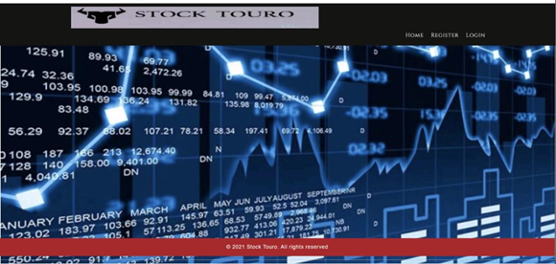
SNAPSHOTS
The above figure indicates the home page/landing page where user can opt between Register page or Login page.

Slide 21
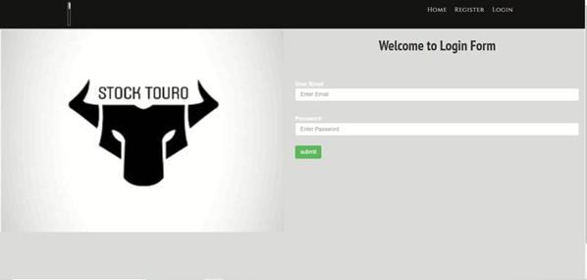
The above figure shows the login page where user can enter his login credentials and login.

Slide 22
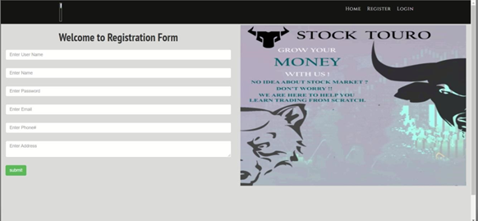
The above figure shows the registration page where user can enter his details for the purpose of logging in.

Slide 23
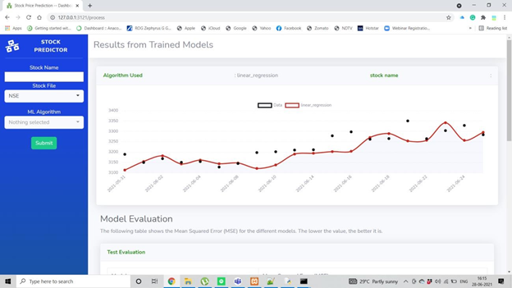
The above figure shows the graphical representation of TCS (Tata Consultancy Services) stock based on linear regression and considering the historical data of the TCS share collected from NSE (National Stock Exchange).

Slide 24
ADVANTAGES
Most of the benefits in the articles depend on the problem domain and the NN methodology used. A common contribution of NN applications is in their ability to deal with uncertain and robust data. Therefore, NN can be efficiently used in stock markets, to predict either stock prices or stock returns. It can be seen from a comparative analysis that the Backpropagation algorithm has the ability to predict with greater accuracy than other NN algorithms, no matter which data model was used. The variety of data models that exist in the papers could also be considered a benefit, since it shows NNs flexibility and efficiency in situations when certain data are not available. It has been proven that NN outperform classical forecasting and statistical methods, such as multiple regression analysis and discriminant analysis. When joined together, several NNs are able to predict values very accurately, because they can concentrate on different characteristics of data sets important for calculating the output. Analysis also shows the great possibilities of NN methodology in various combinations with other methods, such as expert systems. The combination of the NN calculating ability based on heuristics and the ability of expert systems to process the rules for making a decision and to explain the results can be a very effective intelligent support in various problem domains

Slide 25
CONCLUSION
The main objective of our dissertation is to develop a more adaptive and effective stock prediction system by applying machine learning techniques. The survey papers prove the successfully of our proposed approach. A systematic prediction tool is developed could be used to assist invested make more accurate decision in their stock market investment. Our prediction system integrates the stock movement forecasting and stock price forecasting.

